Slide 1
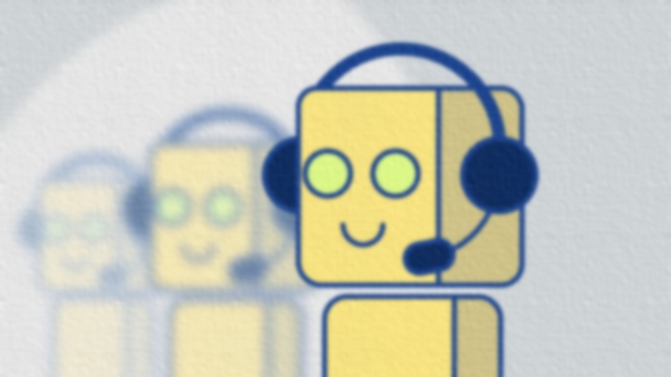

BOTMAN
SJSU CMPE 272 TEAM 30
Nachiket Joshi - 011408956
Sagar Mane - 011419135
Abhishek Madan - 011408969
Saurabh Gedam - 011451674

Slide 2
What is BotMan ?
A framework, as a hosted service (EC2), which would assist developers and non-developers with coding a bot, guide them through the process of setting up of the environment and deploy the bot on the cloud on a single button click.
Anyone can create bot using node and integrate it with his slack channel.
User can focus more on the behavioral part of the bot and less on the configuration part.
Video Link :INTRODUCTORY VIDEO

Slide 3
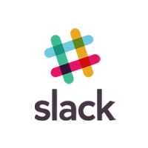



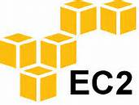
Architecture
5. Bot deployed on Heroku listens
on Slack Channel and replies.
4. Push bot to cloud
and run it to make
it live.
2. Create a Heroku
Directory for deploying
a bot.
Register a new bot
on a channel and obtain
accesses token.
3. Upload bot source code on
Git.

Slide 4
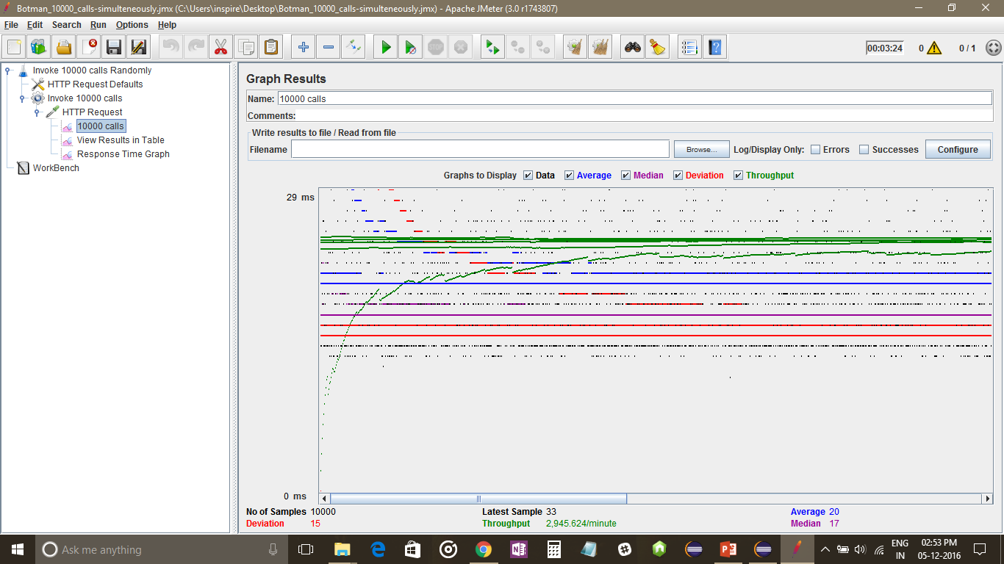
Load test statistics Cumulative Graph:

Slide 5
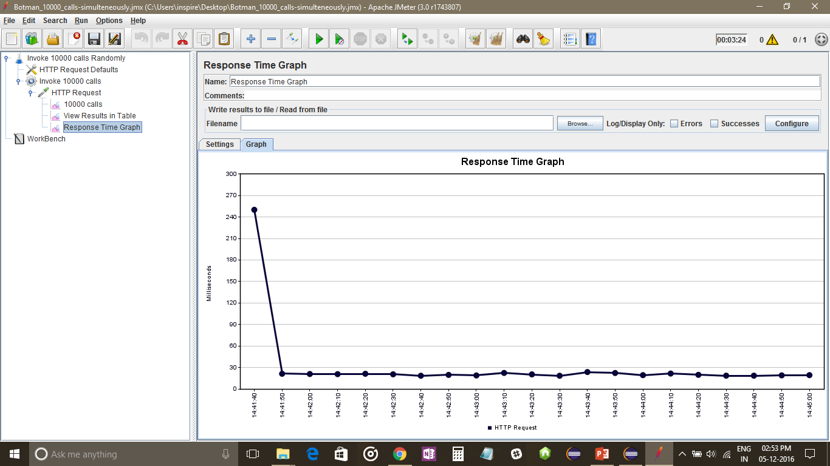
Response Time Graph:

Slide 6
UI Flow

Slide 7
Business Model:
Maintaining Bots uploaded to maintain version systems.
Advertising on the website.
Simplicity and Scalability exercise.
Niche Value:
We can also study data generated by the package.json which will help determine which node libraries are famous amount young developers and how we can improve them.

Slide 8
Future scope
Extending our platforms to support other popular social media platforms like Facebook, Twitter, WhatsApp and Tinder.
Support for more programming languages currently we support node JS bots.
Enhancement of user experience.
Embed a emulator on the website.

Slide 9


Time for Demo!

